Slide 1
Serial Killer Trends in the United States
Alexis Doucette

Slide 2
Questions
How has the number of active serial killers changed over time?
Which states have had the most serial killers?
What are the traits of serial killers?
Demographics (gender, race)
Mental disorders
Criminal History
IQ
How is IQ related to level of organization, number of kills, and method of killing
What are the traits of the victims?
Demographics (age, gender, race)
Relationship to killer
What methods are most frequently used for killing?
What were the motivations for the killings?

Slide 3
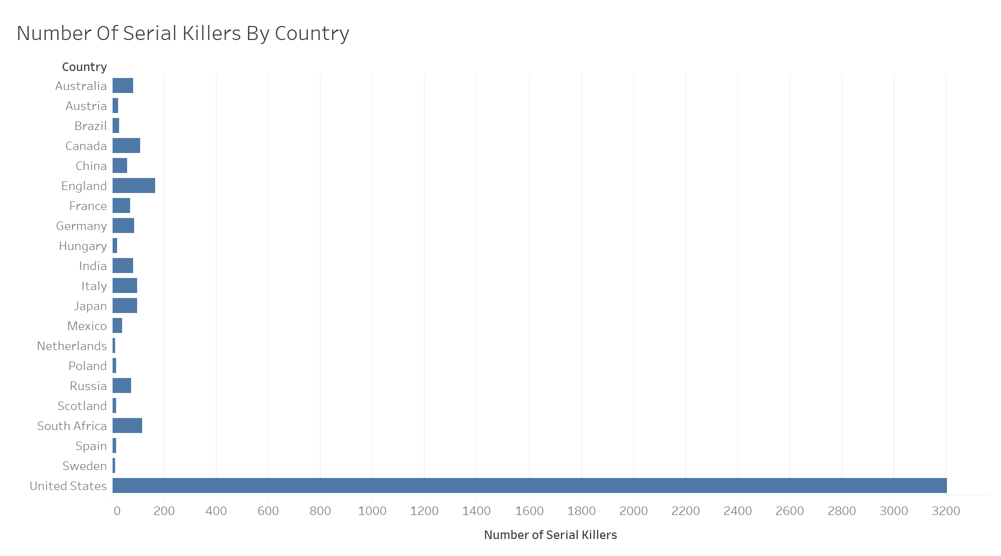
Some Perspective…

Slide 4
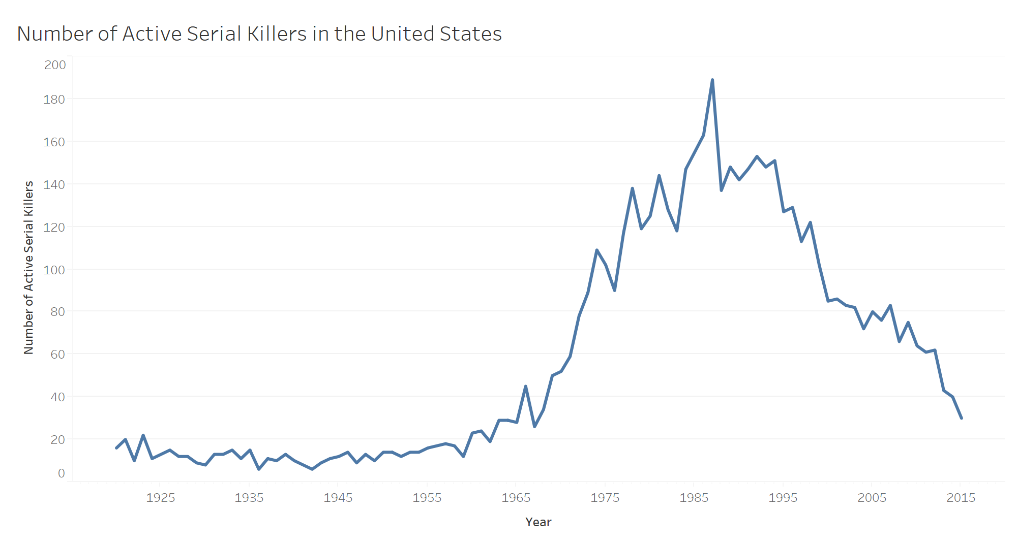
Number of Serial Killers Active

Slide 5
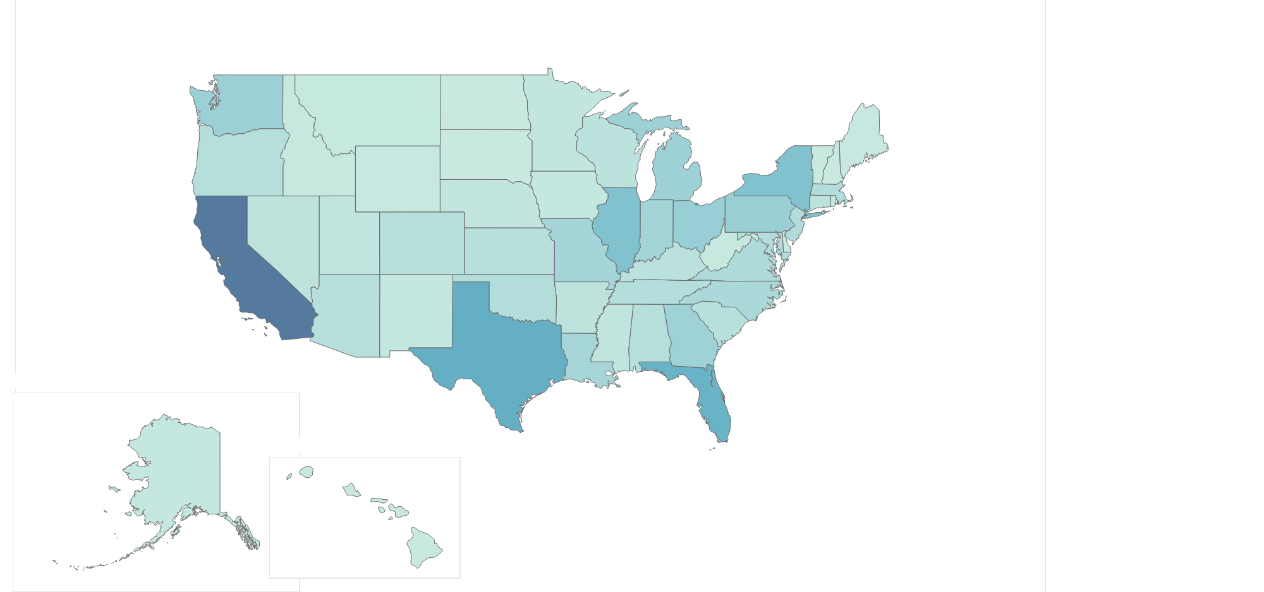
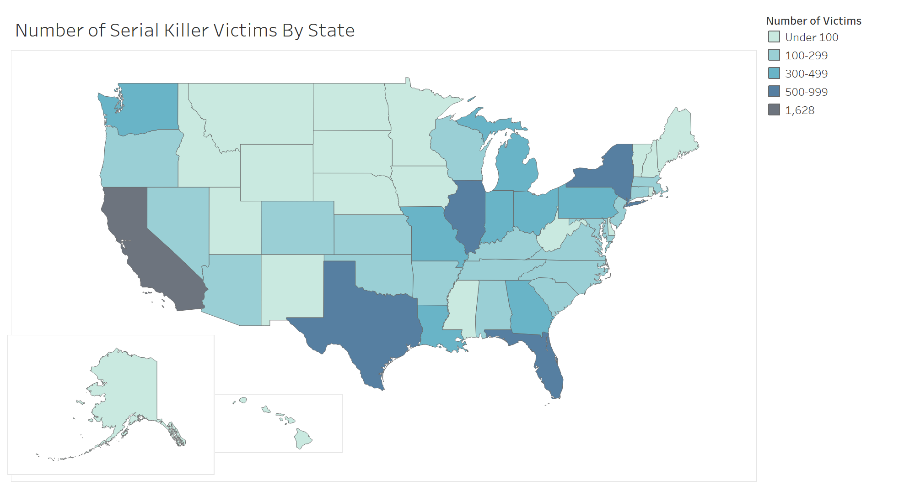
States With Most Victims

Slide 6
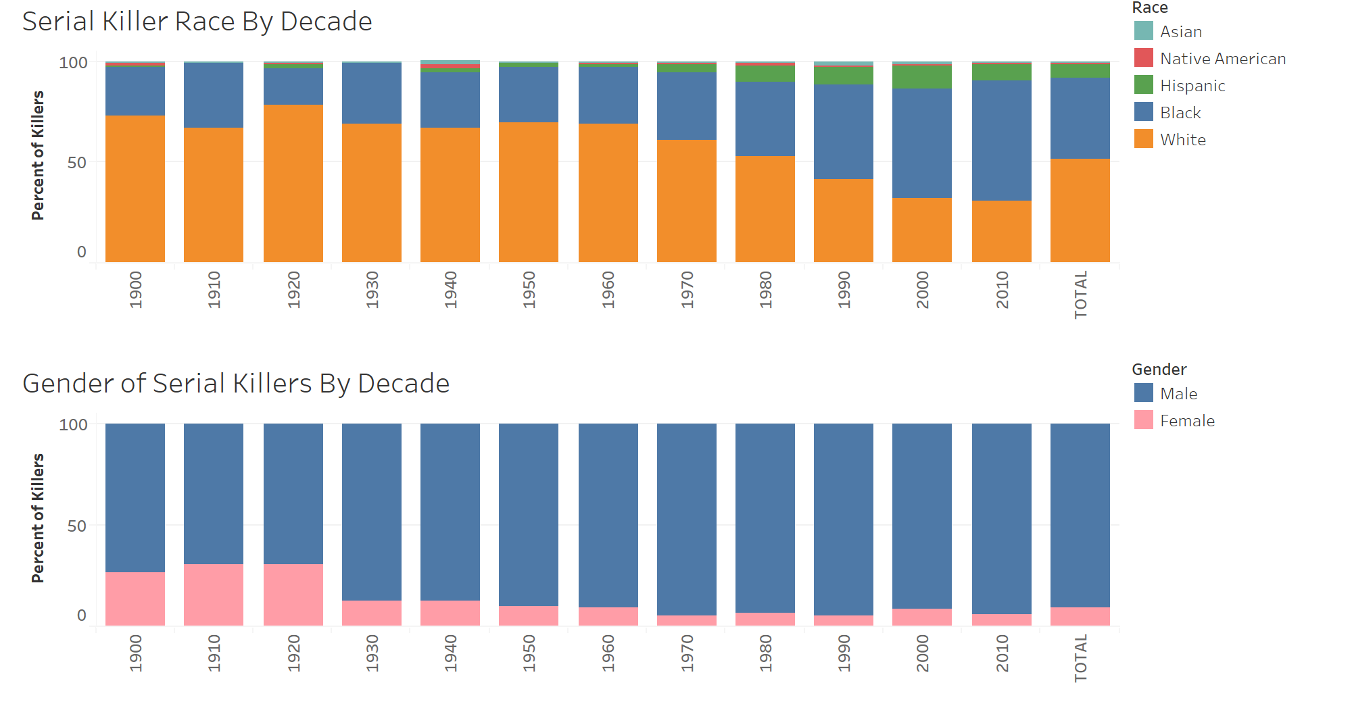
Serial Killer Traits- Race and Gender

Slide 7
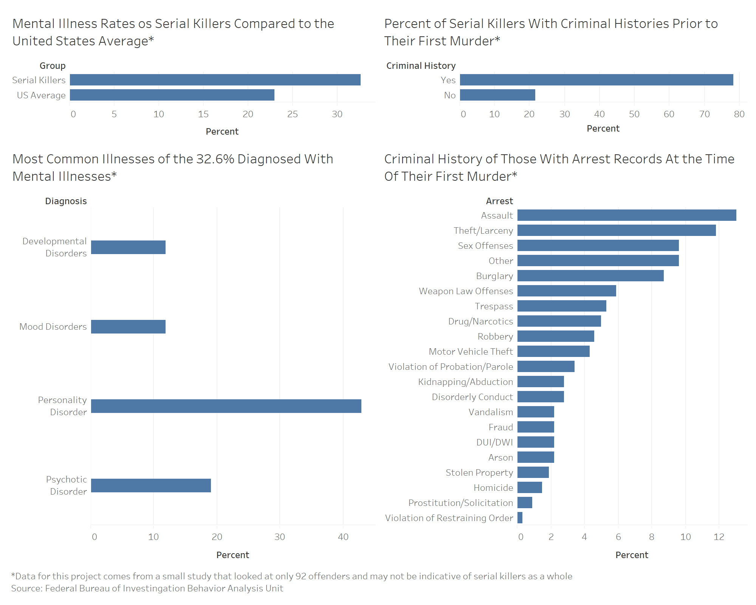
Serial Killer Traits- Criminal History and Mental Health

Slide 8
Serial Killer Traits- Criminal History and Mental Health (Cont.)

Slide 9
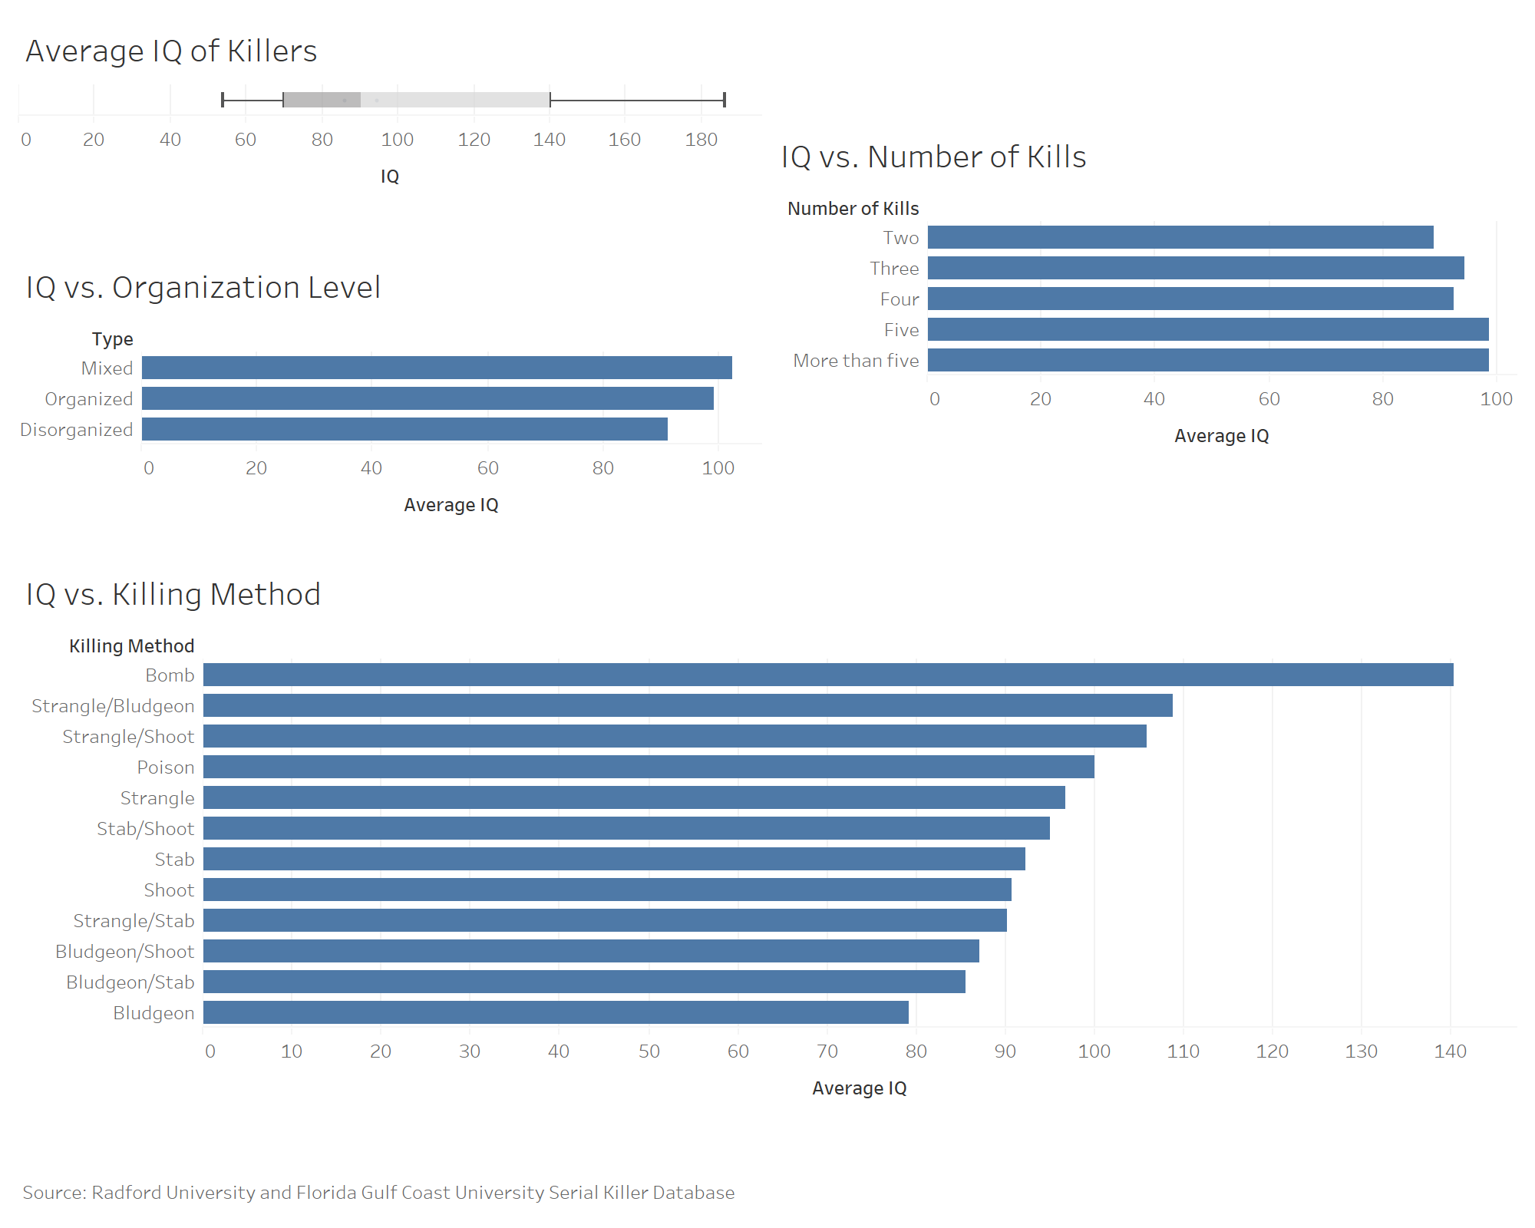
Serial Killer Traits- IQ

Slide 10
Serial Killer Traits- IQ vs. Killing Method

Slide 11
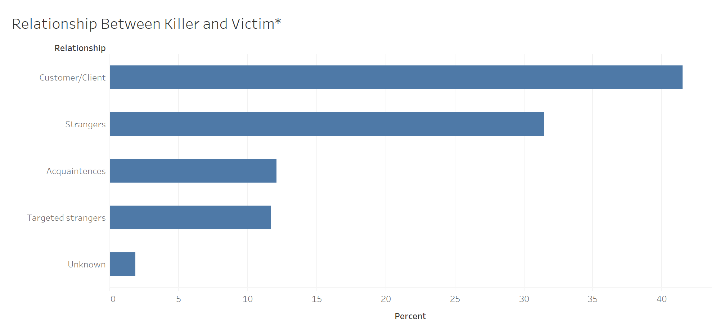
Relationship Between Killer and Victim

Slide 12
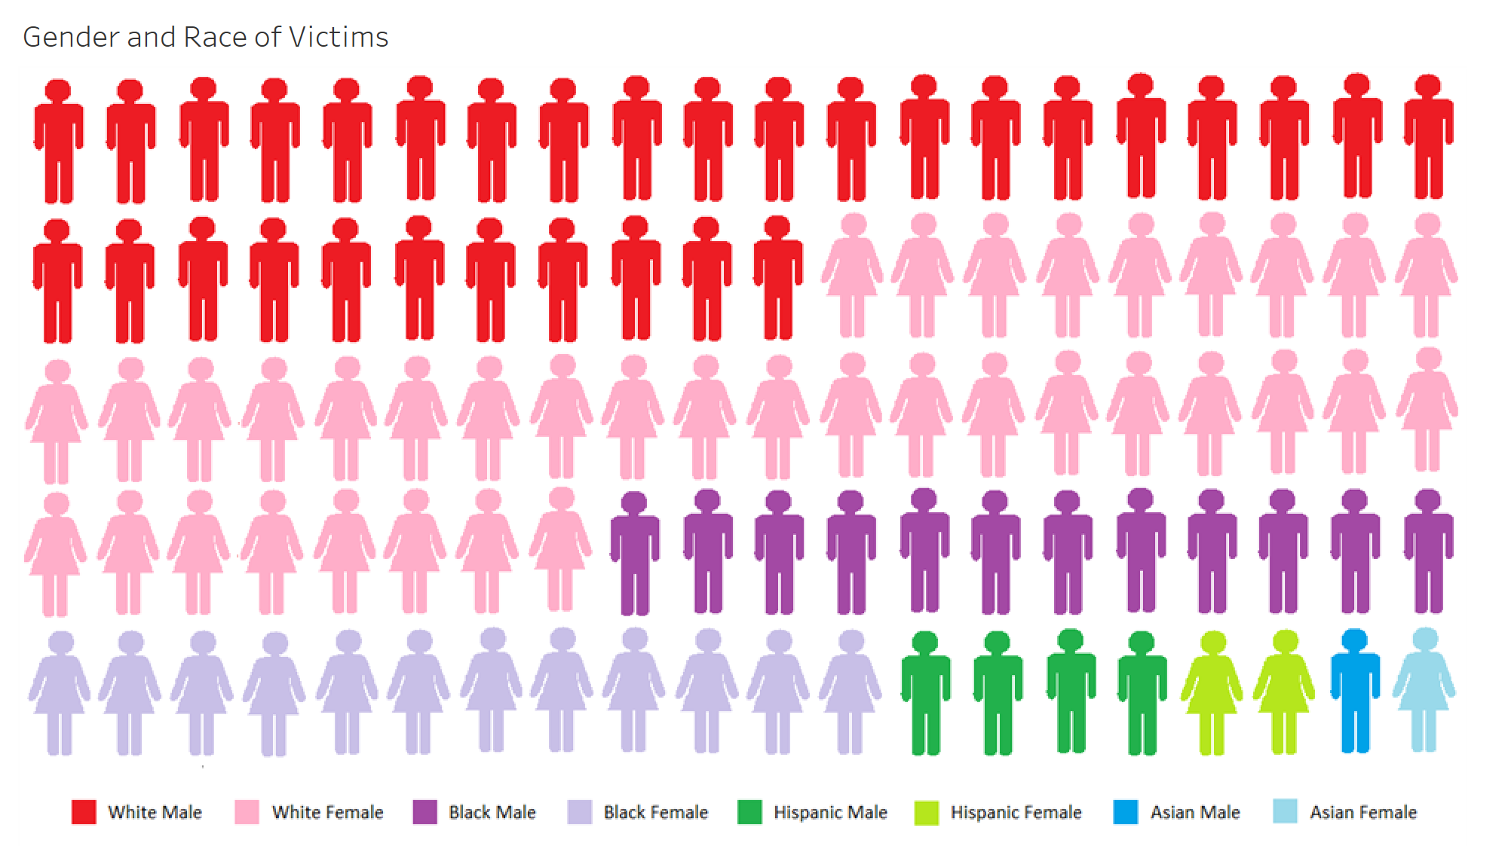
Victim Traits- Race and Gender

Slide 13
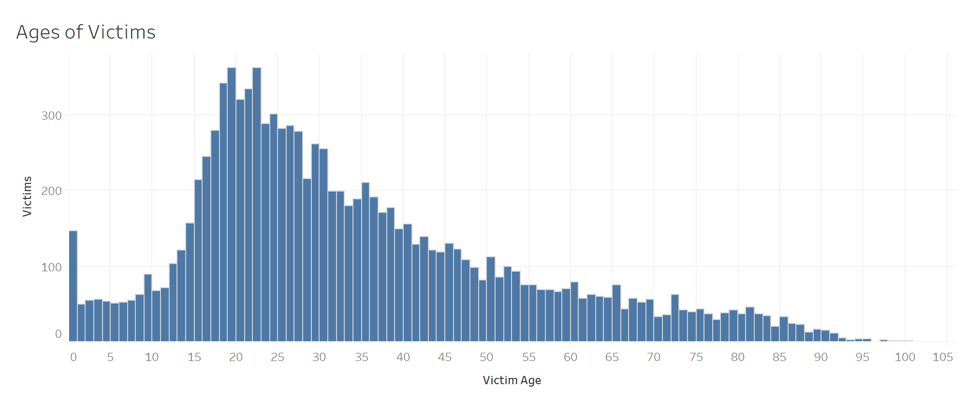
Victim Traits- Ages

Slide 14
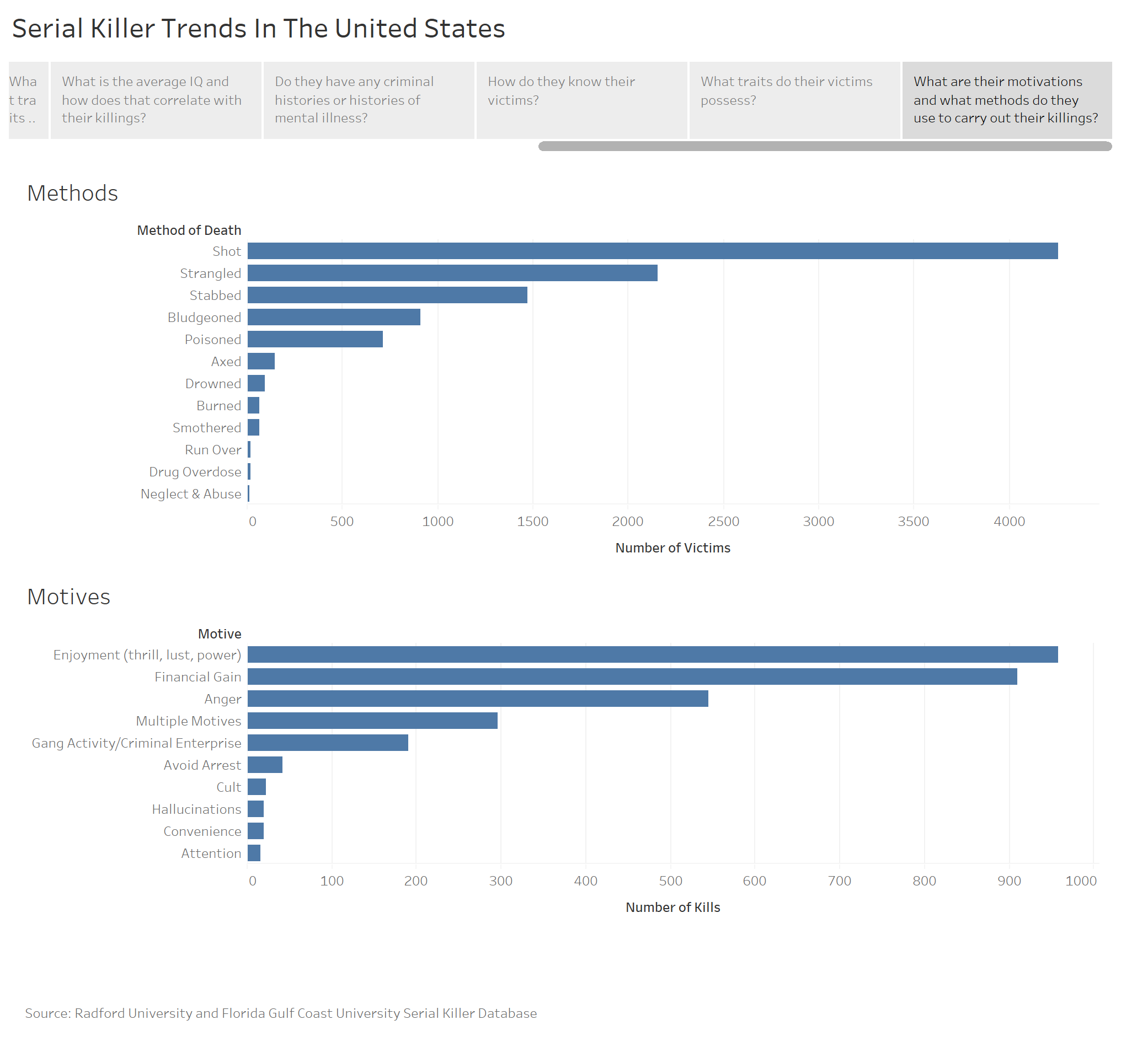
Motivations

Slide 15
Methods Used

Slide 16
Future Work
Look deeper into the methods of serial killers
Where they find victims
How they approach them
Where they kill the victim
How they dispose of the body
Look deeper into the upbringing of serial killers
Occurrence of a traumatic event
Childhood abuse

Slide 17
Data Sources
Radford University/FGCU Serial Killer Database Project (http://maamodt.asp.radford.edu/Serial%20Killer%20Information%20Center/Project%20Description.htm)
Department of Justice, Federal Bureau of Investigation (https://www.fbi.gov/file-repository/serialmurder-pathwaysforinvestigations.pdf/view)

